Slide 1
Flip-Flops
Basic concepts

Slide 2
Flip-Flops
A flip-flop is a bi-stable device: a circuit having 2 stable conditions (0 or 1)
3 classes of flip-flops
  latches: outputs respond immediately while enabled (no timing control)
  pulse-triggered flip-flops: outputs response to the triggering pulse
  edge-triggered flip-flops: outputs responses to the control input edge
1/50
A. Yaicharoen

Slide 3
Conventions
The circuit is set means output = 1
The circuit is reset means output = 0
Flip-flops have two output Q and Q’ or (Q and Q)
Due to time related characteristic of the flip-flop, Q and Q’ (or Q) are usually represented as followed:
  Q_{t} or Q: present state
  Q_{t+1} or Q⁺: next state
1/50
A. Yaicharoen

Slide 4
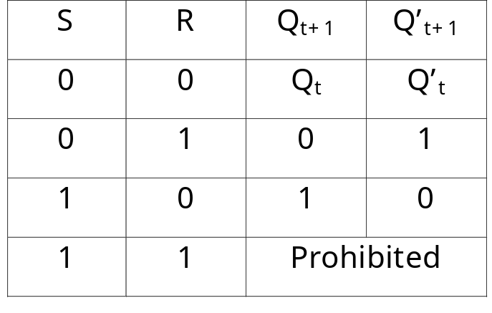
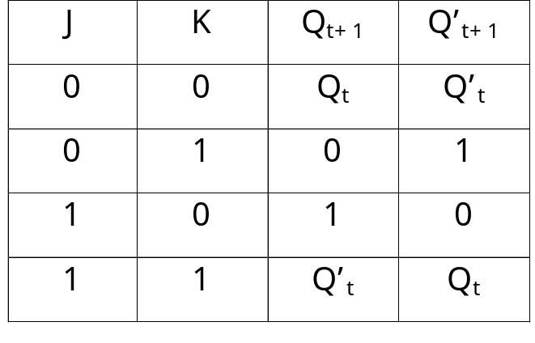
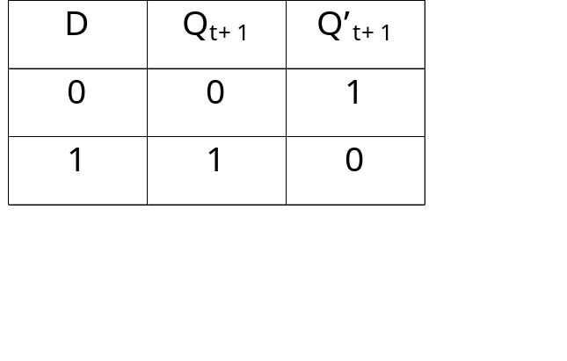
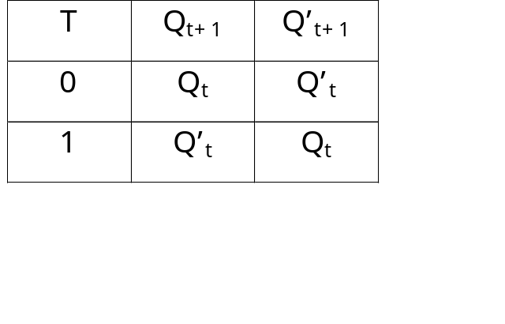
4 Types of Flip-Flops
SR flip-flop JK flip-flop
D flip-flop T flip-flop
1/50
A. Yaicharoen

Slide 5
SR Latch
An SR (or set-reset) latch consists of
  S (set) input: set the circuit
  R (reset) input: reset the circuit
  Q and Q’ output: output of the SR latch in normal and complement form
  Application example: a switch debouncer
1/50
A. Yaicharoen

Slide 6
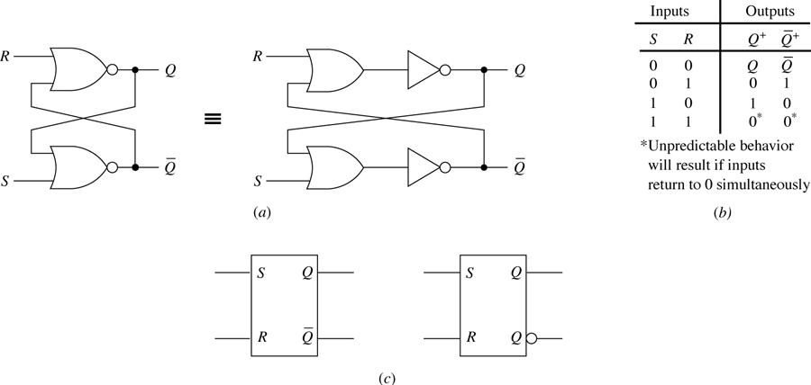
SR latch
1/50
A. Yaicharoen

Slide 7
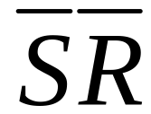
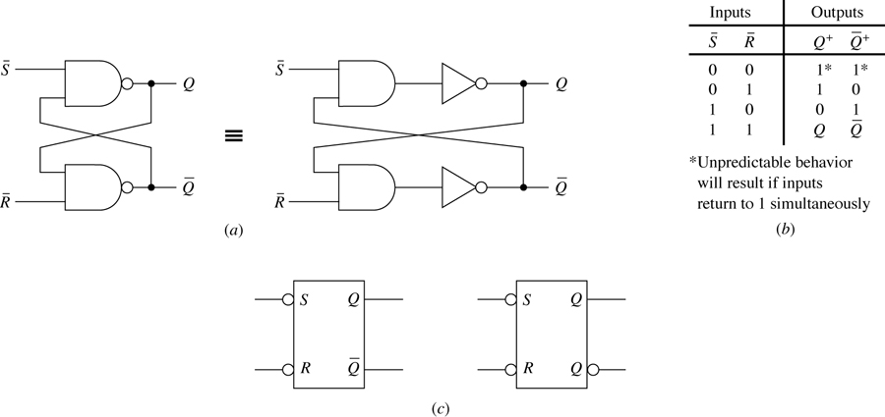
latch
1/50
A. Yaicharoen

Slide 8
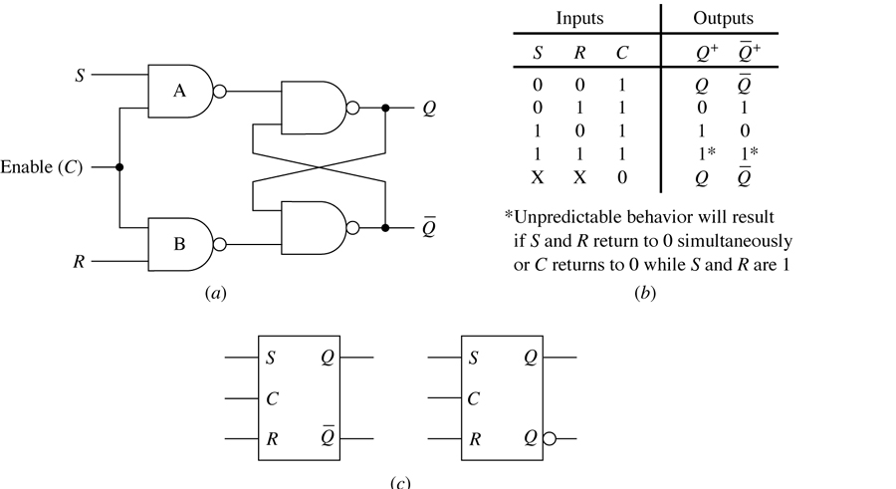
Gated SR latch
(c)
1/50
A. Yaicharoen

Slide 9
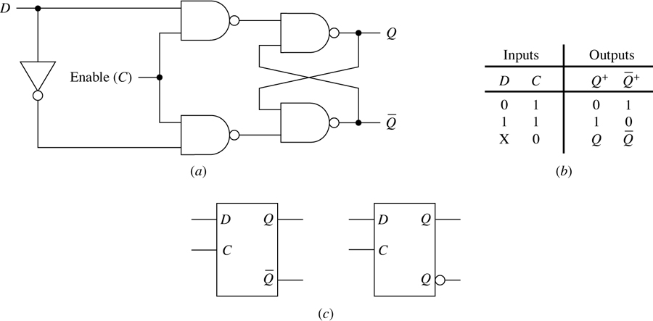
Gated D latch
1/50
A. Yaicharoen

Slide 10
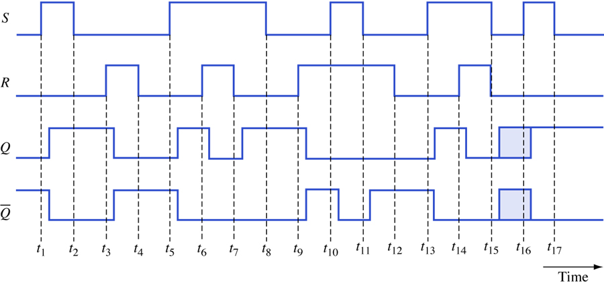
Timing diagram for an SR latch
1/50
A. Yaicharoen

Slide 11
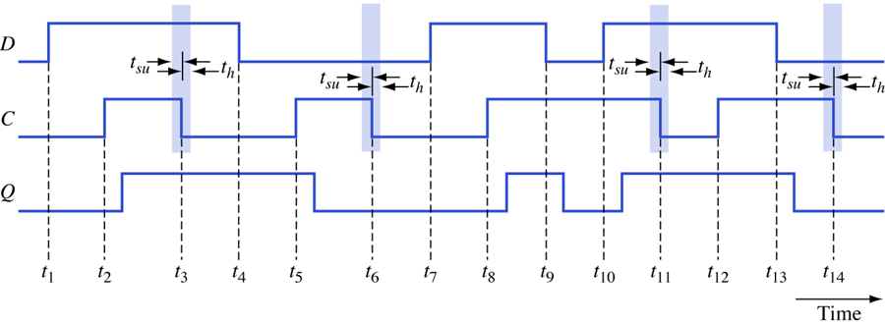
Timing diagram for a gated D latch
1/50
A. Yaicharoen

Slide 12
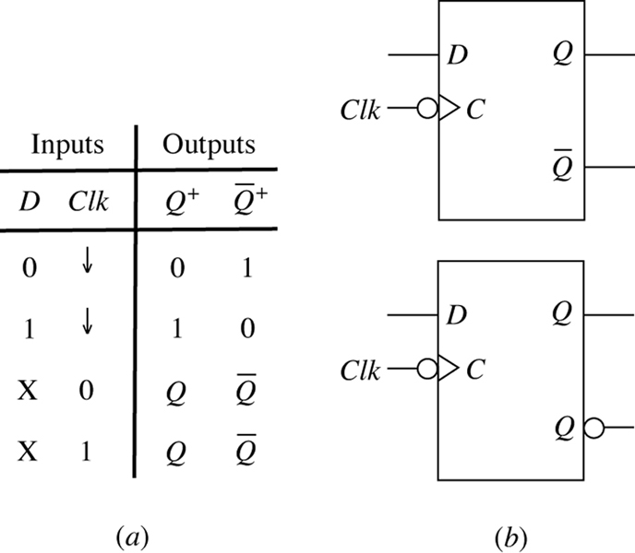
Negative-edge-triggered D flip-flop
1/50
A. Yaicharoen

Slide 13
Asynchronous Inputs
do not require the presence of a control signal
  preset (PR) - set the flip-flop
  clear (CLR) - reset the flip-flop
useful to bring a flip-flop to a desired initial state
1/50
A. Yaicharoen

